Slide 1

Mental Health & Ageing: Volunteer Training

Slide 2


Digital Literacy Foundation
Welcome!
Volunteers are an integral part of the aged care workforce. Many of whom work with older adults from a range of backgrounds, some more vulnerable than others. As such, we have a duty of care to ensure the safety and wellbeing of our clients, by being alert to any changes in their demeanor or behaviour that could suggest a mental health issue might be developing. This training module is designed to provide you with the information you need to better understand the mental health of the clients you are working with. It will give you the skills you need to recognise signs of declining mental health, how to report your concerns to get assistance for your client, and how to support someone with a mental health disorder.

Slide 3
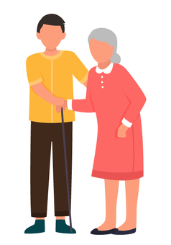
Digital Literacy Foundation
Outcomes and Objectives
This training module has been designed to equip you with the knowledge you need to recognise signs of change or decline in your client’s mental health, and what to do if this occurs.
By the end of this module, you will be able to:
Confidently discuss the issues of mental health in older adults.
Understand the impact ageing can have on our mental health.
Identify the ways our environment influences mental health.
Identify the major mental health issues affecting older Australians.
Recognise the most common symptoms of anxiety and depression in older adults.
Confidently participate in supporting the mental health of older adults.
Learn More

Slide 4
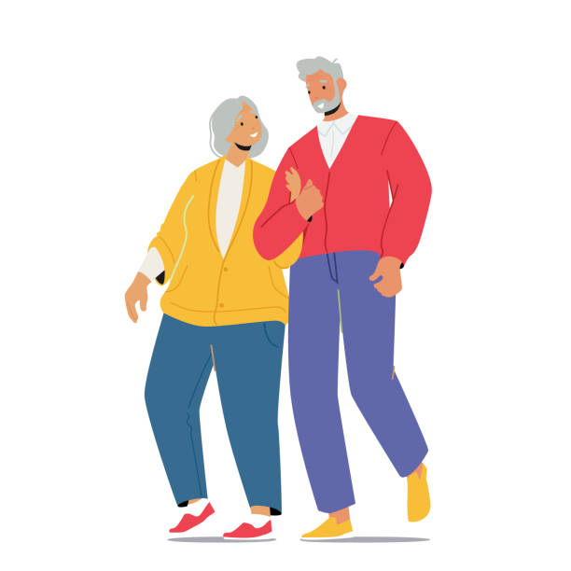
Digital Literacy Foundation
Introduction
Improved healthcare, better living conditions, and lower mortality rates contribute to the increase in longevity in most populations, and while, mental health challenges are not a common part of ageing, there are many factors that can influence the wellbeing of older adults in our community.
For those of us working with older adults and in aged care, it is important that we understand the factors that contribute to the mental health of our clients and what a reduction in mental health looks like. When we know what to look for we can identify risks and report any concerns we have, to not only ensure our clients wellbeing, but to also meet our duty of care responsibilities.
International Federation on Ageing (IFA). https://ifa.ngo/driving-our-agenda/ifas-commitment-to-older-people/

Slide 5
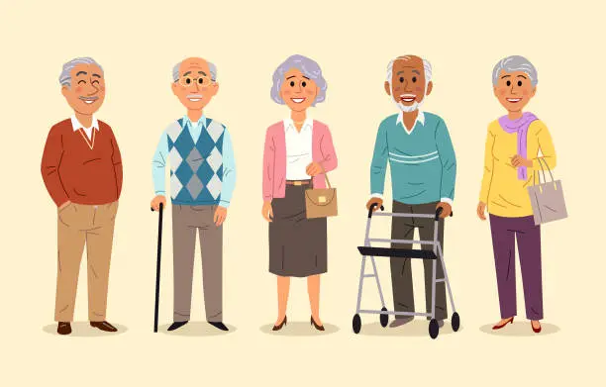
Digital Literacy Foundation
Section 1: What is Ageing?

Slide 6
Digital Literacy Foundation
The ageing process
While there are a many contributors to the ageing process, many of the outcomes we experience are generated by our early social and physical environments. Unsurprisingly, these variations can significantly affect our physical, psychological, and emotional wellbeing in later life.
Ageing is essentially, the physiological changes that occur in our body until death.
It involves a decline of biological functions, accompanied by psychological, behavioural, and other changes, and while ageing is a normal and natural process, the rate at which we age is, as mentioned earlier, individual and a combination of genetics, environment, and lifestyle choices.
At the biological level, ageing results from the effect of the accumulation of molecular and cellular damage over time, which causes:
a gradual decrease in physical and mental capacity, and
a growing risk of disease and ultimately death.
These changes, however, are only loosely associated with our chronological age and instead it is our biological age that really counts when we’re talking about the ageing process.
WHO. (2022). Ageing and health

Slide 7
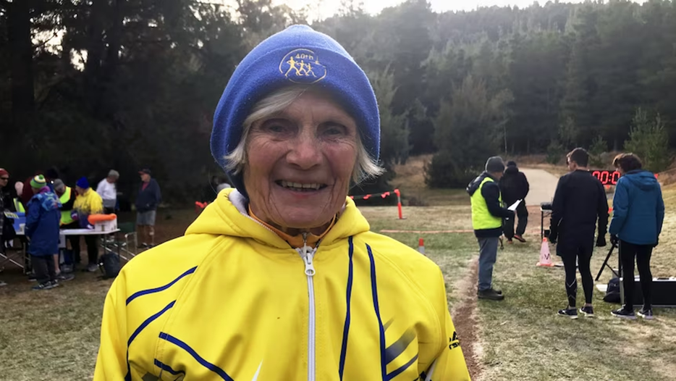
Digital Literacy Foundation
Chronological age vs biological age
Our chronological age is simply the number of years we have lived, while our biological age is the exponential increase in our chances of becoming sick or dying over time. Essentially, it’s the rate at which our body loses function.
While we all have a chronological and a biological age, we don’t all lose functional capacity at the same rate. This means that some people’s biological age may be much younger, or much older, than their chronological age. For example, Caroline Campbell of Australia, who was not only running marathons at 80 years of age but breaking world records at the same time, could be said to be biologically, much younger than her 80 years would generally suggest.
The Conversation. (2023). Your body can be younger than you – here’s how to understand (and improve) your biological age.
ABC News. (2023). Canberra woman running marathons and breaking world records at 80 years of age

Slide 8
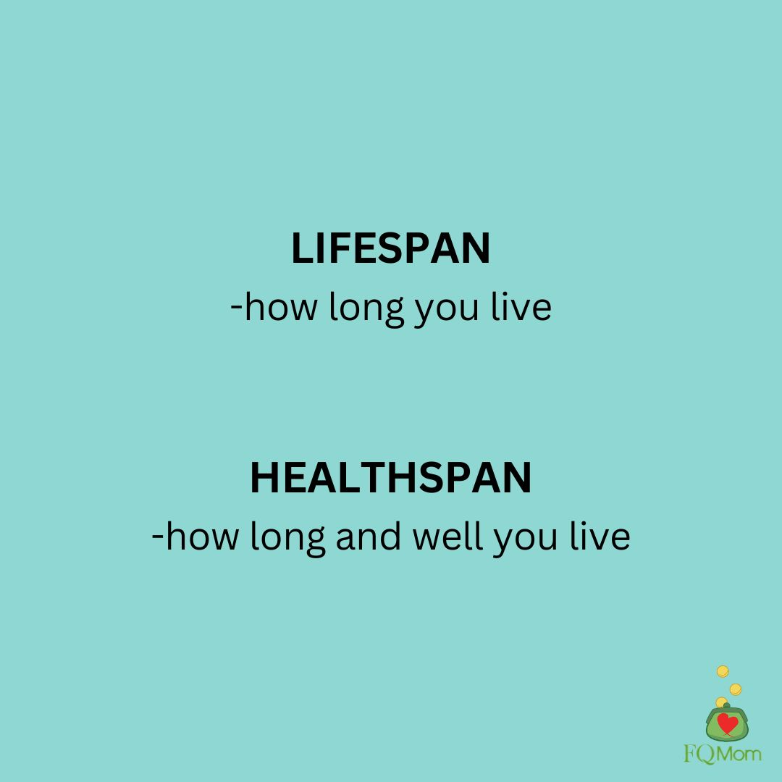
Digital Literacy Foundation
Lifespan vs health span
Longevity and lifespan are interchangeable and, as outlined before, refer to length of life.
Health span, however, refers to the years of life we spend in good health, free from chronic disease or disability. So, while advances in medical technology have contributed to increasing our lifespan, living longer doesn’t always equal living well.
The phenomena of a large ageing population and issues around quality of life, has triggered a growing interest in understanding the factors that contribute to health span and longevity. And with this interest comes research which has found that genetics play a less significant role than first thought.
While genetics have an influence over our potential longevity, it’s environmental factors, lifestyle choices and mental health that are the predominant factors impacting our ability to live a long and healthy life.
NOVOS. (2023). The Mind-Body Connection: How Mental Health Impacts Longevity and Quality of Life

Slide 9
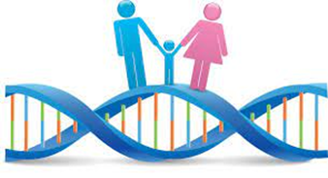
Digital Literacy Foundation
Factors affecting lifespan
There are many factors that will influence our lifespan, some out of our control - like where we lived as children, genetic disposition, and our childhood experiences - and some within our control, such as lifestyle choices, self-care, and help-seeking.
Genetic predisposition
A genetic predisposition is an increased likelihood of developing a particular disease based on our genetic makeup. It results from specific genetic variations that we inherit that contribute to the development of disease without directly causing it.
Having a genetic predisposition, is simply an indicator that, under certain conditions, we’re more likely to develop a particular illness. However, it usually takes more than one contributing factor, to trigger the disease we're susceptible to.
National Cancer Institute. (2026). NCI Dictionary of Genetics Terms: genetic predisposition

Slide 10

Digital Literacy Foundation
Mental and emotional state
Having a significant mental health issue may also affect our lifespan and health span. For example, chronic stress increases the release of cortisol and while an episodic response to stress is a protective mechanism, repeated and continued release has been linked to the onset of several diseases, including cardiovascular disease, cognitive impairment, and other chronic conditions.
Additionally, having an untreated mental illness can generate long-term impacts on physical health, reducing life expectancy just as much as diabetes, smoking, and lack of exercise do. According to WHO, serious mental health disorders can reduce life expectancy by 10-to-25-years, which is the same as, or worse, than heavy smoking.
Males aged over 85 years have the highest suicide rate of all age groups (32.7 deaths per 100,000 persons in 2022). In 2022, females aged over 85 years had the highest suicide rate of all female age groups (10.6 per 100,000). The most common psychosocial risk factor associated with suicide deaths in those aged over 65 years was limitation of activities due to disability.
WHO. (2018). Management of physical health conditions in adults with severe mental disorders
Life in Mind. (2023). Older Adults

Slide 11
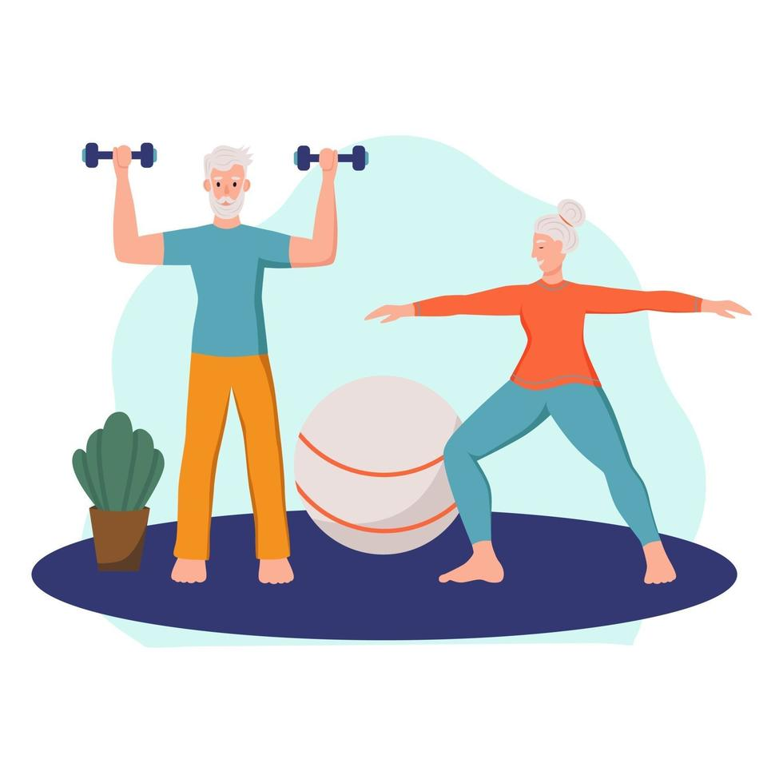
Digital Literacy Foundation
Lifestyle choices
Lifestyle choices such as smoking, and a lack of exercise can impact lifespan and health span. Indeed, being sedentary, using opioids, and smoking have the biggest negative impact on lifespan leading to a 30-45 per cent higher risk of death.
As well, stress, binge drinking, poor diet, and poor sleep hygiene are all associated with around a 20 per cent increase in the risk of death.
But lifestyle choices aren’t just about diet and exercise, it’s also about our social selves with research finding that loneliness may be the biggest threat to survival and longevity, with feelings of loneliness directly impairing the immune system, making us less resistant to diseases and infections.
Independent. (2023). Scientists share the 8 habits that could take 20 off your life.

Slide 12
Digital Literacy Foundation
Socioeconomic inequality
Our socioeconomic status across the lifespan can also significantly impact our longevity and health span, when financial resources are insufficient to meet basic living needs, such as adequate heating, appropriate clothing, adequate nutrition, and access to medical care and other services.
The gap in life expectancy between the richest 1% and poorest 1% of individuals was found to be:
14.6 years (95% CI, 14.4 to 14.8 years) for men, and
10.1 years (95% CI, 9.9 to 10.3 years) for women .
University of Melbourne. (2020). Australia’s life expectancy stagnates, inequality widens: research.

Slide 13
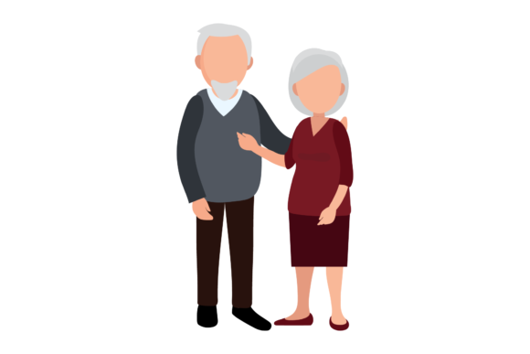
Digital Literacy Foundation
Gender
It has long been known that the lifespan of women is, on average, almost 8% longer than men's. In fact, 57% of the population aged 65 and older are female, while by the age of 85, 67% of the population is female.
There are a range of reasons why researchers believe this may occur, including that:
Men are 50% more likely than women to die of heart disease.
Men commit suicide more often than women (this is true even though depression is considered more common among women and women make more non-fatal suicide attempts).
Men are less socially connected, having fewer and weaker social connections which increases mortality.
Men are far more likely to skip routine health screens and are far less likely than women to have seen a doctor of any kind during a 12-month period.
Harvard Education Publishing. (2020). Why men often die earlier than women.

Slide 14
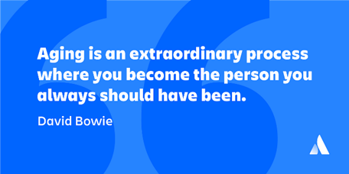
Digital Literacy Foundation
Attitude
Research around positive and negative attitudes/optimism and pessimism have continually shown that those of us with positive attitudes as we age outlive those with negative attitudes.
This is because optimistic people have been found to have a reduced risk of heart disease, stroke, and declines in lung capacity and function. Optimism is also associated with a lower risk of early death from cancer and infection.
Again, it’s not just a reduced risk of disease that affords optimists a longer life, with research suggesting that positive thinking about ageing itself, can increase our will to live, making us more resilient to illness and more proactive about our health.
Harvard Education Publishing. (2019). If you are happy and you know it…you may live longer.

Slide 15
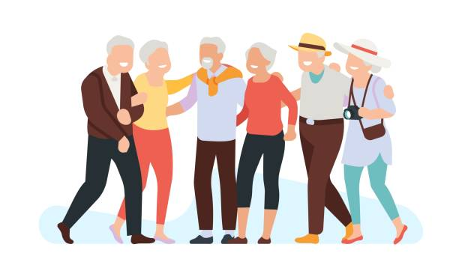
Digital Literacy Foundation
Section 2: What is Successful Ageing?

Slide 16
Digital Literacy Foundation
Successful ageing
One of the fundamental definitions of successful or active ageing sits around our ability, as we get older, to develop new skills to effectively adapt to the changes and demands that come with the ageing process.
Active ageing, as defined by the World Health Organisation (WHO), is a framework with three core areas: health, participation, and security.
Health
Extending healthy life expectancy and reducing the risk of chronic disease and frailty. This focuses on physical activity, nutrition, and preventative healthcare.
Participation
Continuing to contribute to the workforce, family, and community through volunteering, social connection, and lifelong learning.
Security
Ensuring adequate protection, dignity, and care for older adults as their physical or cognitive needs change.
Within this definition, everyone can experience healthy ageing, and it doesn’t mean being free of disease or infirmity. Indeed, many older adults have one or more health conditions that, when well controlled, have little influence on wellbeing. Instead, healthy ageing is the process of developing and maintaining the functional ability that enables wellbeing in older age.
World Health Organisation. (2002) Active Ageing: A Policy Framework.

Slide 17
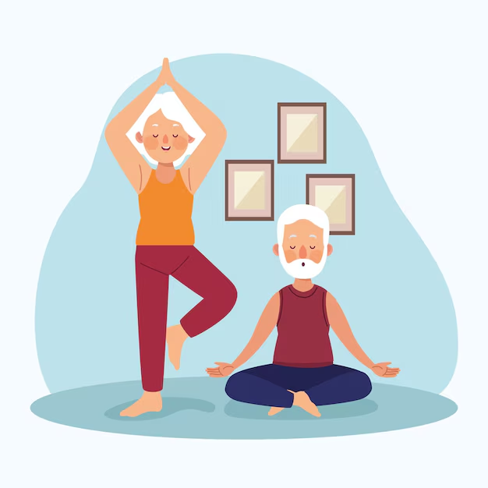
Digital Literacy Foundation
Elements of successful ageing
In recent research on successful ageing six key themes have been identified including:
Being actively engaged and independent
Being physically active and having sound wellbeing
Having resilience and a sense of acceptance
Having social-emotional connection and support
Promoting and maintaining good health
Being mentally healthy and cognitively sound.
Essentially, when we have a sense of purpose, a positive attitude toward ageing, the ability to adapt to inevitable change, a level of independence, and a good support network we can continue to engage with the world and keep our sense of self. And while there are many ways we can age successfully, there are also barriers to ageing well that can make it difficult to adapt and maintain a sense of purpose. We will look at these barriers next.
Burton E, Teater B, Chonody J, Alford S. What Does It Mean to Successfully Age?: Multinational Study of Older Adults' Perceptions. Gerontologist. 2024 Oct 1;64(10):gnae102. doi: 10.1093/geront/gnae102. PMID: 39126227; PMCID: PMC11407851.

Slide 18
Digital Literacy Foundation
Barriers to successful ageing
One of the most significant barriers to successful ageing is the decline in the valuing of older adults over the past century.
Since industrialisation and modernisation, the attitudes of modern and developed societies have become primarily ageist, with recent research finding that ageism is a significant issue in the mental health of older adults.
Ageism
According to a recent United Nations report on ageism, approximately every other person in the world holds ageist attitudes, creating an entrenched challenge for society and older adults themselves.
In the study, more than 83 000 respondents in 57 countries were asked about their attitudes to older people across all age groups, with the lowest levels of respect found in the highest income countries.
And while the data confirms that ageism is extremely common in society, most of us are completely unaware of the subconscious stereotypes we hold about older people and how these manifest in the way we treat the older adults around us.
Kang H, Kim H. Ageism and Psychological Well-Being Among Older Adults: A Systematic Review. Gerontol Geriatrics Med. 2022 Apr 11;8:23337214221087023. doi: 10.1177/23337214221087023.
United Nations. Department of Economic and Social Affairs Ageing. (2021). Global Report on Ageism.

Slide 19
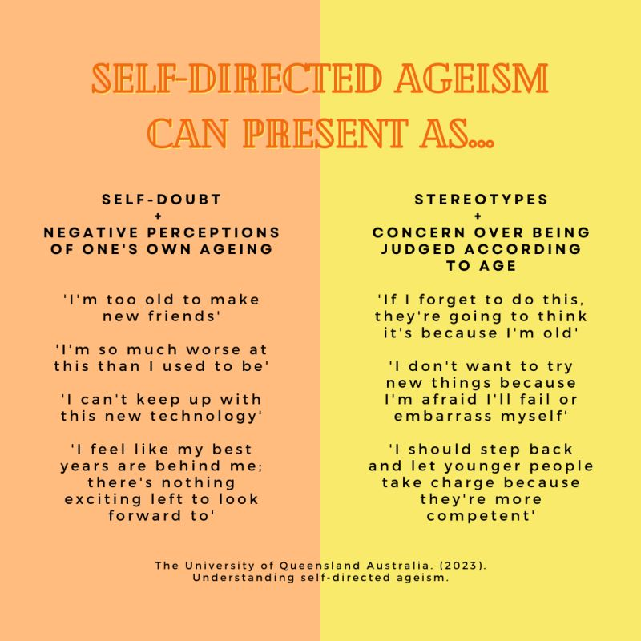
Digital Literacy Foundation
Self-directed ageism
One of the problems that has been identified around entrenched societal ageism is that it can easily be turned inward and become self-directed. This significantly impacts our sense of self and our overall mental health and wellbeing. Indeed:
Research has found that older people who feel a burden to others perceive their lives to be less valuable, putting them at risk of depression and social isolation.
Older people who hold negative views about their own ageing, don’t recover as well from illness and disability and live on average 7.5 years less than people with positive attitudes.
World Health Organisation. (2016). Discrimination and negative attitudes about ageing are bad for your health.
Association for Psychological Science. (2009). Stereotype Embodiment: A Psychosocial Approach to Aging.

Slide 20
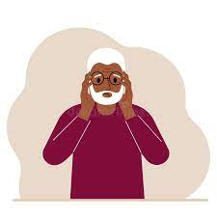
Digital Literacy Foundation
The phenomenon of self-directed ageism refers to the process by which age stereotypes influence the health of older adults. Essentially, the attitude of a society towards ageing impacts older adults across a three-step process:
Age stereotypes are internalised from the host culture at a young age (we grow up believing getting old is bad).
At some point, these age stereotypes become "self-stereotypes" about oneself as an ageing individual (as we get older, we believe we will be in pain, a burden, or have no purpose).
These self-stereotypes or self-perceptions are then consciously and unconsciously activated to exert their effects on individual health (we can become less proactive about health and hygiene, become depressed, and even lose the will to live).
World Health Organisation. (2016). Discrimination and negative attitudes about ageing are bad for your health.
Association for Psychological Science. (2009). Stereotype Embodiment: A Psychosocial Approach to Aging.

Slide 21

Digital Literacy Foundation
And this all leads to biological, psychological, and physiological changes that create a self-fulfilling prophecy with self-directed ageism:
making the symptoms of depression and anxiety worse,
increasing stress, and
negatively affecting overall mental health.
The impact of this is particularly high in men.
Ageism and suicide risk
Studies show that ageism and self-directed ageism raise our suicide risk by weakening protective factors, such as self-esteem, self-efficacy, and hopefulness. This, in turn, may make someone feel like a burden or make them feel disconnected from their support system. These factors can lead to suicidal ideation and suicidal intent.
Research suggests “age rejectors” have better mental health overall, including greater ego strength and an active mastery style. They don’t deny their age, but they refuse to adopt the negative stereotypes that may be associated with it. They have a more positive self-image than their peers who identify as old and sick, old and weak, or
old and lonely.
Julie D. Henry, Sarah P. Coundouris, Fergus I.M. Craik, Courtney von Hippel, Sarah A. Grainger, The cognitive tenacity of self-directed ageism, Trends in Cognitive Sciences, Volume 27, Issue 8, 2023, Pages 713-725, ISSN 1364-6613, https://doi.org/10.1016/j.tics.2023.03.010.

Slide 22
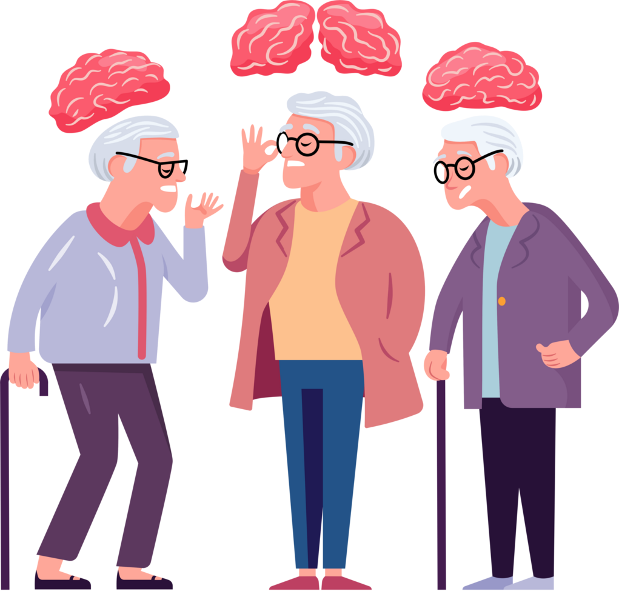
Digital Literacy Foundation
Section 3: Mental Health

Slide 23
Digital Literacy Foundation
What is mental health?
Just like physical health, everyone has mental health, and it’s influenced in both positive and negative ways by many factors across our lifespan. As the World Health Organisation (WHO) suggests, “There is no health without mental health,” and while we won’t all experience a mental illness in our lifetime, we will all certainly struggle with our mental health at some point in our lives.
Indeed, just like we all have challenges with our physical health from time to time, our mental health can be similarly compromised.
Mental health is recognised as the level of wellbeing we have that allows us to cope with ordinary life pressures. It exists on a continuum from coping to not coping, affecting how we think, feel, and behave at any given time.
According to WHO, when we are experiencing good mental health, we can:
cope with the normal stresses of life
work productively
realise our potential, and
contribute to our community.
WHO. The Global Health Observatory. Health and Wellbeing
WHO. (2022). World mental health report: Transforming mental health for all

Slide 24
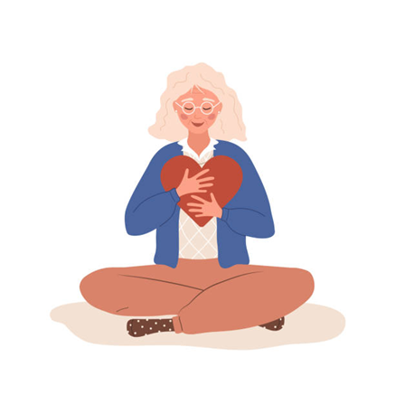
Digital Literacy Foundation
In effect, good mental health exists when we experience a state of wellbeing that enables us to:
deal with whatever life throws at us through the mechanism of flexible thinking,
experience an overall enjoyment of life, and
maintain an ability to connect with others.
Having good mental health doesn’t mean feeling good all the time, however, life comes with risks, worries and losses that can create challenges to our sense of wellbeing. Instead, good mental health supports us develop helpful coping skills and strategies to successfully move through challenges as they arise, building our self-confidence and providing a sense of empowerment.
Department of Health and Aged Care. (2022). About Mental Health
Mental Health Foundation. (2023). About Mental Health

Slide 25
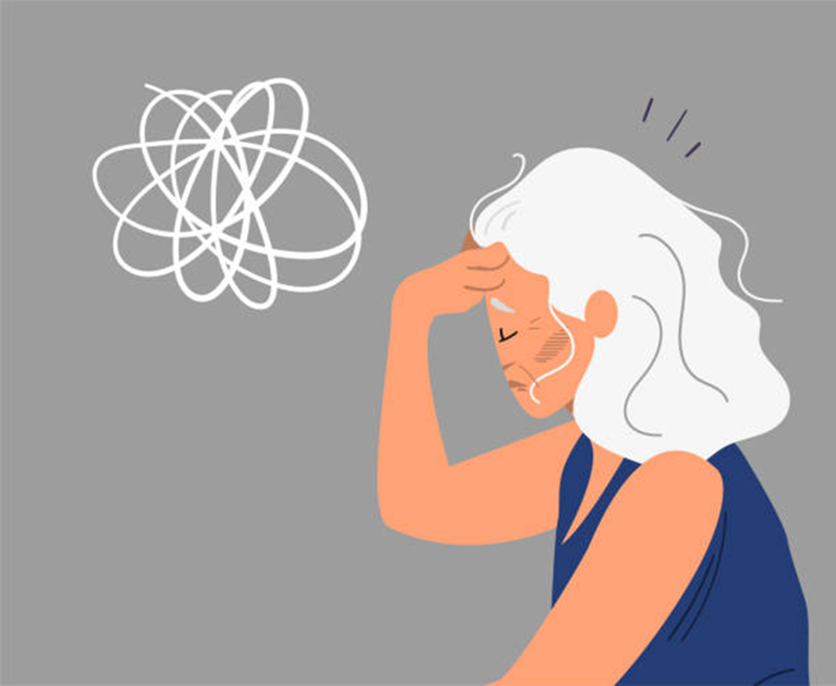
Digital Literacy Foundation
Mental health as we age
While the consensus is that as we get older, we experience less anxiety and stress overall, research also suggests that as we move to older age, we can experience higher levels of psychological distress.
Psychological distress describes the unpleasant feelings or emotions we can have when we feel overwhelmed. These emotions and feelings can get in the way of our daily living and influence how we react to the people around us, manifesting as agitation, impatience, or lethargy for example. Psychological distress can look like:
fatigue
sadness
anxiety
avoidance
fear
anger
moodiness
Health -University. (2023). Psychological Distress
Australian Institute of Health and Welfare. (2015). Australia’s Welfare. Mental health of older Australians.

Slide 26
Digital Literacy Foundation
Given the nature of ageing, experiences of significant psychological distress are not uncommon and can be triggered by a range of social factors or life events such as the loss of a loved one or receiving a diagnosis of a serious health problem.
As we age, we are inevitably confronted by more, and more distressing events during this time. This not only sits around the distress of losing a partner and/or friends, but of our shifting identity, reduced income, a loss of some/all independence, and the need to downsize from the family home.
Essentially, the transitions that occur as we age, are potentially very confronting, and if not managed well, can lead to a range of mental health disorders including:
depression
substance abuse
dementia
anxiety, and
suicide (particularly in men over 80).
WebMD. (2021). What to Know About Mental health in Older Adults.

Slide 27
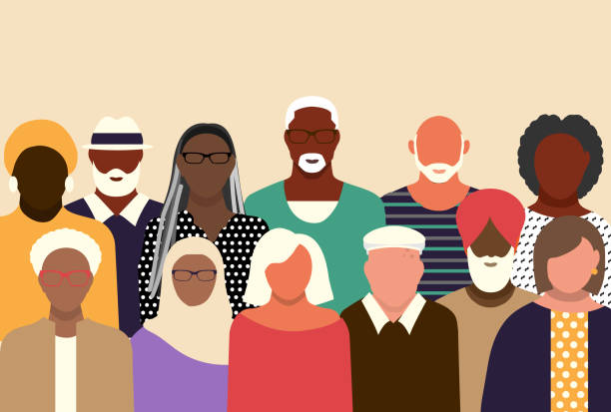
Digital Literacy Foundation
Older adults from diverse backgrounds
Older people from culturally and linguistically diverse (CALD) communities face a range of issues in addition to the stressors that can affect all older people. These issues include loss of language, cultural identity, and social isolation, especially for those living in aged care homes.
Indeed, international research shows that severe mental illness may be higher in the immigrant and refugee population than in host communities due to pre-migration, migration and settlement stresses. As well, research in this field has revealed that discrimination, racism and marginalisation can act as a barrier to accessing services for culturally diverse seniors which can also have an impact on their mental health.
Australian Institute of Health and Welfare. (2015). Australia’s Welfare. Mental health of older Australians.
Centre for Cultural Diversity In Ageing. (2024). Culturally Appropriate Mental Health Support for Culturally Diverse Seniors

Slide 28
Digital Literacy Foundation
There are many factors that can impact the mental health and wellbeing of older people from CALD communities. These factors vary based on migration, refugee, and resettlement experiences, and include :
Isolation, loneliness, and lack of extended family support.
Grief and loss as part of the migration experience.
The challenges of ageing in an unfamiliar cultural environment.
The loss or deterioration of English language and first language skills especially with the onset of dementia.
Re-emergence of symptoms of post-traumatic stress in later life for older people who arrived in Australia as displaced persons and experienced previous trauma and/or torture.
A loss of identity or sense of disconnection because of migration.
Lower socioeconomic status of some older people from CALD backgrounds.
Reduced access to mental health information and services.
Delayed help-seeking behaviour leading to delayed diagnosis of mental illness.
Department of Health NSW. (2023). Transcultural mental health centre: older people.

Slide 29
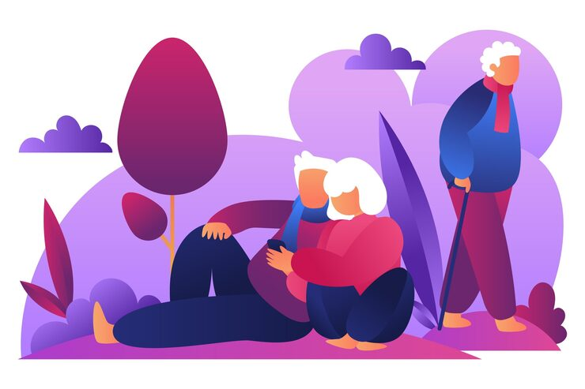
Digital Literacy Foundation
Section 3: Creating Mental Health

Slide 30
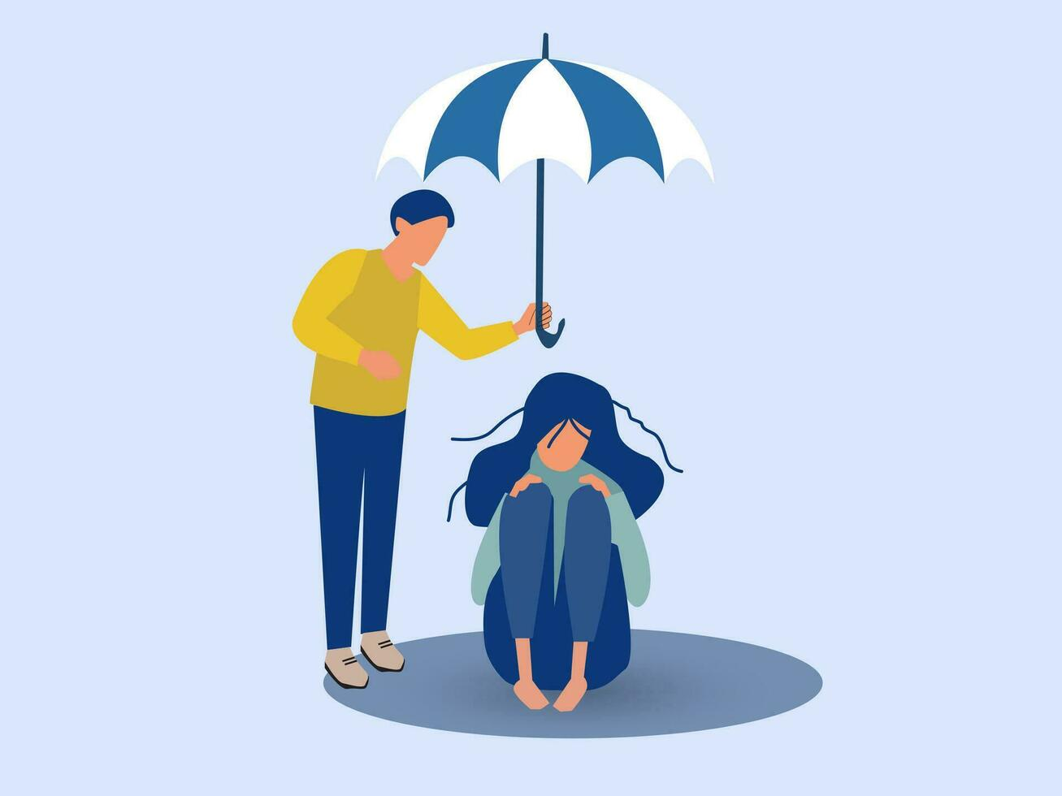
Digital Literacy Foundation
Building mental health
Our mental health exists on a continuum that ranges from thriving, sometimes referred to as flourishing, to being in crisis, or psychologically injured. And, where we are on that continuum at any given time is influenced by several variables that are rooted in our early years, including our family situation, culture, community, environment, and genetics. These variables can be either protective factors or risk factors.
Protective factors
Protective factors are those variables that help prevent or mitigate issues that may trigger poor mental health such as:
supportive relationships
helpful coping skills
feeling valued, and
hope for the future.
WHO. (2022). Mental health

Slide 31
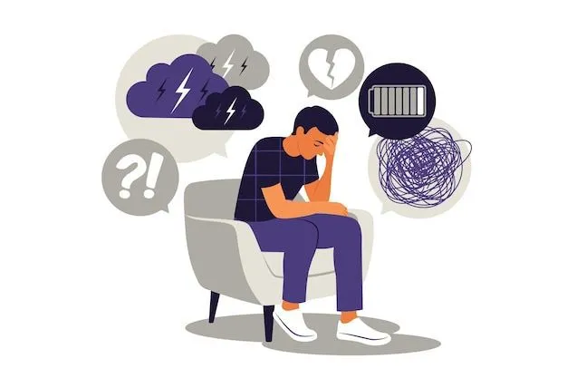
Digital Literacy Foundation
Risk factors
Risk factors are the opposite of protective factors and are the internal and external variables that can worsen our mental health such as:
social isolation
unhelpful coping skills
poverty, and
childhood trauma (e.g., death of a parent, domestic violence, other abuse).
WHO. (2022). Mental health

Slide 32
Digital Literacy Foundation
Mental health and your environment
As we’ve mentioned, health and wellbeing are determined not only by our genes and personal characteristics but also by the physical and social environments in which we live our lives. The environments in which we live and have lived, play an important role in determining our physical and mental capacity across our life course, as well as how successfully we adjust to loss of function and other forms of adversity that we may experience in our later years.
Indeed, for older adults, an unhealthy environment contributes to a fast and early decline in both physical and mental capacity and increases vulnerability, while a healthy environment contributes to extra years spent in good health. And this phenomena is particularly reflected when older adults have to move to aged care facilities.
World Health Organisation. (2023). Age-friendly Environments
Agostino Di Ciaula, Piero Portincasa, The environment as a determinant of successful aging or frailty, Mechanisms of Ageing and Development,Volume 188, 2020,
111244, SSN 0047-6374, https://doi.org/10.1016/j.mad.2020.111244.

Slide 33
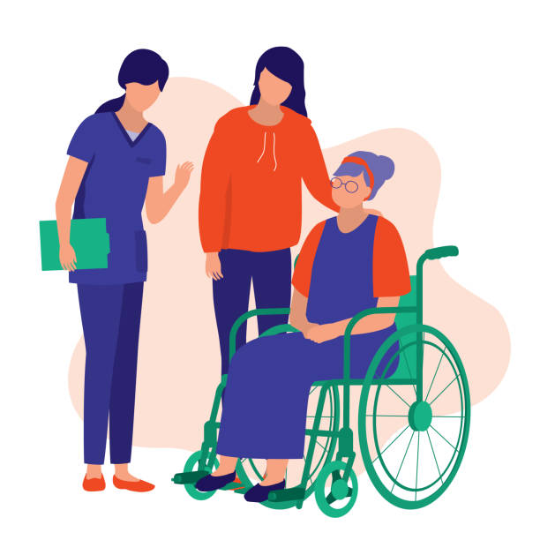
Digital Literacy Foundation
Aged care and relocation stress
The move from home into residential care is one of the most stressful life experiences for older adults. ‘Relocation stress’ is a significant risk factor for mood disorders such as anxiety and/or depression in aged care residents. Whether long-term or recently diagnosed, these mood disorders are associated with a decline in overall wellbeing, daily functioning and independence. As we know, the mental health needs of older adults are often poorly recognised and supported, including during the transition into residential care.
The term ‘relocation stress ’ has come to represent the particularly strong responses to the transition into aged care of older adults, including heightened confusion, anxiety, depression and loneliness. Admission to residential aged care often follows a crisis, such as a fall at home or hospitalisation, and with little time to prepare, older adults are often marginalised in the decision-making process and may not know that the admission is permanent.
As such, the transition into residential aged care is considered one of the most stressful life experiences for older adults.
Polacsek, M., Woolford, M. Strategies to support older adults’ mental health during the transition into residential aged care: a qualitative study of multiple stakeholder perspectives. BMC Geriatr 22, 151 (2022). https://doi.org/10.1186/s12877-022-02859-1

Slide 34
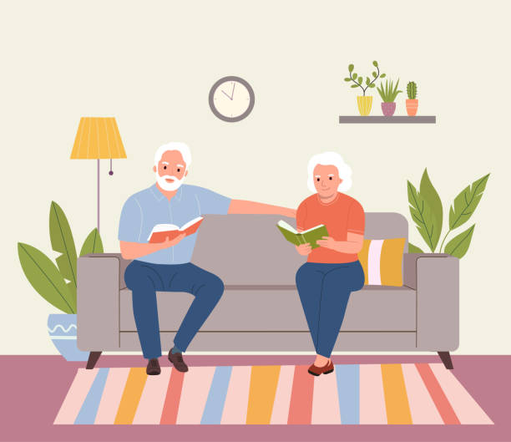
Digital Literacy Foundation
Ageing in place
One of the main benefits of older adults living at home is the preservation of their independence. Home is a place where familiar surroundings can help maintain a sense of identity and safety. By staying at home, older adults can retain control over their daily routines, make decisions that align with their preferences, and maintain a sense of autonomy.
The freedom to manage our own life contributes significantly to emotional wellbeing, which empowers older adults to live life on their own terms. This emotional connection to their home also fosters a positive state of mind, reducing anxiety, and promoting overall happiness.
Additionally, if they live close to family and friends, staying at home can help older adults to maintain important social connections and may also help them stay connected to regular health services and service providers, such as doctors, dentists and hairdressers, as well as community organisations and activities they enjoy.
Getting support to stay at home such as receiving help with garden maintenance, house cleaning, and home maintenance, etc., is vital for ageing in place.
Better Health Channel. (2025). Living at home as you get older

Slide 35

Digital Literacy Foundation
Section 4: Mental Health and Ageing

Slide 36
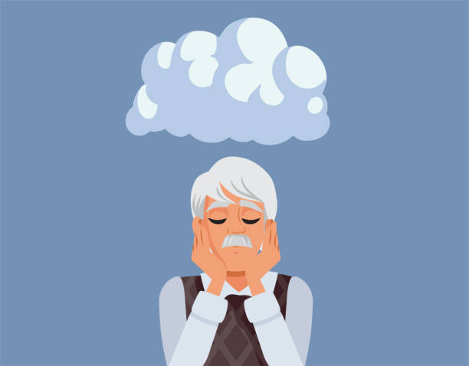
Digital Literacy Foundation
Common mental health issues
According to WHO, around 14% of adults aged 60 and over live with a mental health disorder, the most common of which are depression and anxiety.
Additionally, older adults in aged care and other supported accommodation settings are at increased risk of mental health issues with 3 in 5 aged-care residents having a mental health condition (50% experiencing depression and up to 60% a clinically significant anxiety disorder).
Unfortunately, mental health conditions among older people are often under-recognised and under-treated, and the stigma surrounding these conditions can make people reluctant to seek help.
WHO. (2023). Mental health of older adults
Australian Psychological Society. (2023). Supporting the mental health of Australia's aged-care residents

Slide 37
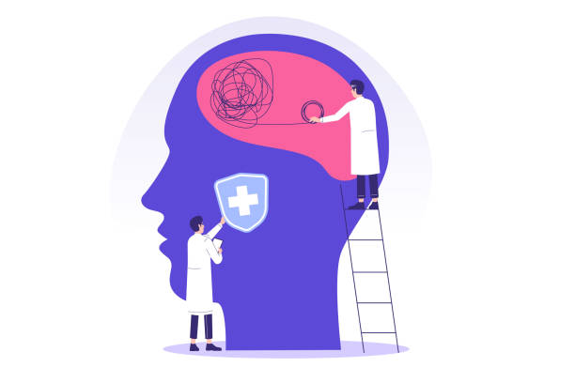
Digital Literacy Foundation
Risk factors for mental health issues in older age
Risk factors associated with the development of depression and anxiety in older age, include:
social isolation and loneliness
elder abuse
illness
frailty and loss of independence
grief and loss
financial stress
changing living arrangements
cognitive impairment
WHO. (2023). Mental health of older adults
Health Direct. (2024). Older people and mental health

Slide 38
Digital Literacy Foundation
Depression
Depression is a common problem among older adults, but it is not a normal part of ageing. In fact, most older adults feel satisfied with their lives, despite often having more illnesses or physical challenges than younger people.
There are several types of depression that older adults may experience:
Major depressive disorder
Persistent depressive disorder
Substance/medication-induced depressive disorder
Depressive disorder due to a medical condition
National Institute on Aging. (2025). Depression and Older Adults

Slide 39
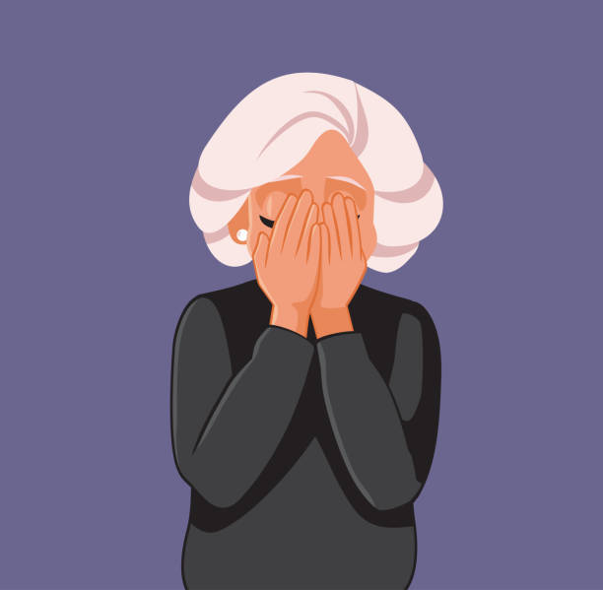
Digital Literacy Foundation
Symptoms of depression
The following are common symptoms of depression in older adults, but because individuals can experience depression differently, there may be other symptoms not listed below. Any changes in someone’s behaviour should be explored.
Persistent sad or “empty” mood.
Feelings of hopelessness, guilt, worthlessness, or helplessness.
Loss of interest in once pleasurable activities, including sex.
Decreased energy or fatigue.
Difficulty concentrating, remembering, or making decisions.
Difficulty sleeping, waking up too early in the morning, or oversleeping.
Increased use of alcohol or drugs, or engagement in high-risk activities.
Thoughts of death or suicide, or suicide attempts.
National Institute on Aging. (2025). Depression and Older Adults

Slide 40
Digital Literacy Foundation
Anxiety
Anxiety disorders in older adults are fairly common, affecting 10% to 20% of people, however, they often go undiagnosed. Anxiety is found more often than depression and cognitive disorders in older adults. The most common anxiety disorders in older adults include:
Generalised Anxiety Disorder (GAD)
Phobias
Panic disorder
Obsessive-Compulsive Disorder (OCD)
Post Traumatic Stress Disorder (PTSD)
WebMD. (2025). What to Know About Anxiety in Older Adults

Slide 41
Digital Literacy Foundation
Symptoms of anxiety
People of all ages will typically show the same signs of anxiety however some types of disorders may have specific symptoms. Common symptoms of an anxiety disorder include:
Panicky feeling.
Dizziness or feeling lightheaded.
Digestion problems and chest pain.
Headaches.
Irritability.
Avoidance of activities, places, people, and even thoughts that trigger anxiousness.
Changes in weight, appetite, or eating habits.
Inability to sleep.
Not wanting to leave home, withdrawal, and isolating themselves.
Obsessive thoughts and compulsive behaviour.
WebMD. (2025). What to Know About Anxiety in Older Adults

Slide 42
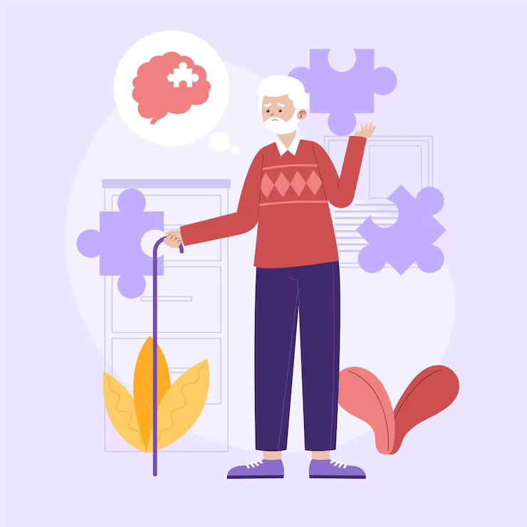
Digital Literacy Foundation
Section 5: Supporting Mental Health

Slide 43
Digital Literacy Foundation
Duty of care
All volunteers and members of Volunteer Involving Organisations (VIOs) have a duty of care in all their dealings with clients, stakeholders, and others. Volunteers are expected to:
Take reasonable care to avoid injury to yourself, or another person, or to damage property because of any action or inaction.
Not be careless or negligent in your dealings with clients or others.
Report to authorities any person you observe, or suspect is being careless, negligent, or abusive.
Report any concerns of abuse toward clients to your Volunteer Coordinator/Supervisor.
If you observe changes in your clients’ wellbeing – physical, mental or emotional – please let someone know so that they can take steps to ensure their safety and ongoing wellbeing.

Slide 44
Digital Literacy Foundation
Supporting a client with a mental health issue
Volunteers are not expected to administer Mental Health First Aid or take responsibility for the mental health of their Client. Instead, the role of volunteers is to observe and report any concerns and to offer the same kind of care and kindness they would to a friend in need. The stigma attached to mental health disorders in older adults is real and common, so it is important that we don’t judge others for the thoughts, feelings and behaviours their condition can create, but instead just ensure their time with us is as easy as possible.
As such, it is important that volunteers practice ‘care’ towards their clients. The kind of ‘care’ volunteers can offer involves:
patience
nonjudgement and acceptance
a willingness to listen, and
understanding.
We’ll investigate what this looks like, next.

Slide 45
Digital Literacy Foundation
Patience
Patience is important for maintaining balance in the face of both adversity and day-to-day stress. When we increase our tolerance for life's inconveniences, we can move through each day a little more peacefully. Being patient also means giving our clients the space to be human, to have bad days, and to make mistakes, without fear of immediate judgement or harsh reactions. Patience fosters an environment where our clients can feel safe to express themselves and where mutual respect can flourish.
How to do it
Practicing patience requires intentionality and mindfulness, that is, recognising the automatic responses we tend to have in stressful situations and choosing to respond differently. We can show this when we:
Pause before reacting - take a deep breath and pause in moments of irritation.
Set realistic expectations - impatience often stems from having unrealistic expectations of others.
Practice empathy - try to put yourself in the other person's shoes. Empathy can dissolve anger and frustration and replace it with understanding and kindness.
Young, E. (2024). Cultivating Patience: Understanding the Hidden Struggles of Others

Slide 46
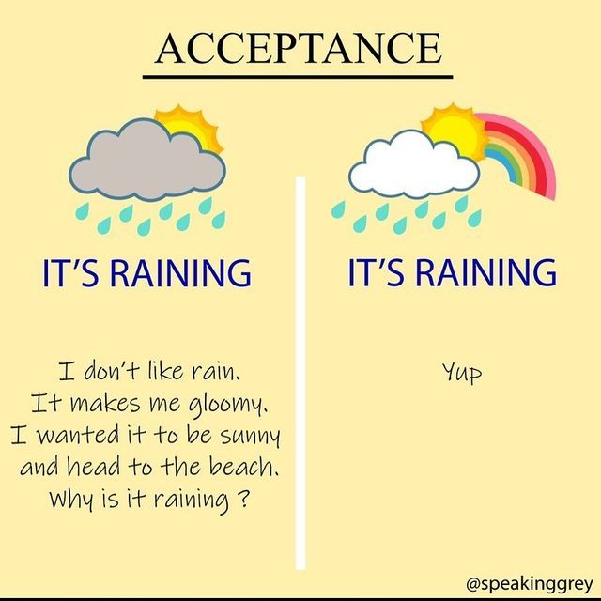
Digital Literacy Foundation
Nonjudgement
Our brains are judging machines, in that everything we experience is filtered, categorised, and dealt with in some way, often without our conscious effort. This means that we are constantly making judgements about people, things, and situations which influences the way that we react and respond to others. When we are working with others, our judgements can inadvertently mean we treat them poorly. When we practice nonjudgement, we learn to accept people for who they are and where they are, without wanting to change them.
How to do it
Practicing nonjudgement involves:
adopting the stance of an impartial witness
working to manage automatic, critical reactions
fostering acceptance and curiosity, and
reducing emotional reactivity.
Mindful Ambition. (2025). Non-Judgment: What is it? And Why Does it Matter?

Slide 47
Digital Literacy Foundation
Willingness to listen
A willingness to listen to our clients comes from being open and receptive to hearing and considering their opinions, thoughts, or feelings. It is about being curious and interested in others and the lives they have lived.
How to do it
Listening properly to others is about putting the other person first, to really hear what they have to say. We can do this by:
Waiting our turn to speak - we can't listen if we are talking over others.
Concentrating on what the other person is saying – consciously focusing our attention on the person's words, ideas and feelings.
Asking open-ended questions – this shows we’re interested and encourages the other person to keep talking.
Paraphrasing what has been said to ensure we understand – this demonstrates that we are both listening and trying to understand the other persons story, feelings or beliefs.
Princeton University. (2025). Learning to Listen

Slide 48
Digital Literacy Foundation
Understanding
Understanding others is a skill that involves the ability to think about our own and others, mental states. It includes the ability to recognise emotions, desires, beliefs, and knowledge, and know that other people's thoughts and beliefs may differ from our own.
How to do it
Understanding others means being open-minded and nonjudgemental by accepting people as they are and not how we wish them to be.
Pay attention to emotion cues – communication is a whole person experience, so we need to pay attention to body language too.
Show sensitivity to others - express interest and concern for others, especially when they are having a difficult time.
Recognise our own biases – we all have them, and they can interfere with our ability to empathise and be open to and validate others’ experiences.
Pham. J. M. (2024). Understanding Others: A Cornerstone of Social Intelligence

Slide 49
Digital Literacy Foundation
Encouraging wellness
Volunteers engaging in one-on-one face-to-face activities with their older clients are in a unique position to observe any changes in their wellbeing, as well as learn their interests and encourage engagement in those interests and activities.
When we truly listen to someone with an open-mind and curiosity we make them feel seen and heard and we validate their current and past life experiences. This is an extremely powerful gift to give someone because, as we have learned, ageism creates a view where older adults are believed to have little to contribute and/or are a burden on society. Yet when we recognise and accept the emotions, memories and experiences of our clients, we help them to preserve their sense of identity and self-worth.
To proactively age well, it is important that our clients can maintain a sense of purpose and identity which can drive health giving activities even if they have health or other issues that may undermine their self-esteem, or sense of self. Volunteers play an important role in encouraging older adults to continue to enjoy the activities, hobbies, and interests that reflect who they are. This might include helping them to stay connected with their interests, spend time with friends and family, and participate in social activities, in whatever capacity their current health status allows them to.
Positive Psychology. (2021). What Is Validation in Therapy & Why Is It Important?

Slide 50

Digital Literacy Foundation
Summary
As you can see, while developing a mental health disorder isn’t a normal part of ageing, older people can be vulnerable to developing depression or anxiety due to life events, a genetic predisposition and other risk factors including a negative attitude toward getting older and old age, as well as environments that are not supportive.
Understanding mental health in older adults is an important tool for helping us to support our clients and alert others when we have concerns about their wellbeing.
Thank you for undertaking this learning module. We hope it is has provided opportunities for reflection and increased understanding

